Slide 1

The Internet

Slide 2
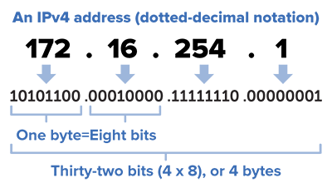
The Internet
The internet is a worldwide collection of computer networks that are connected together (Inter-networking).
In order to join the Internet, every device needs a unique IP (Internet Protocol) Address.

Slide 3
IP address
A numerical address made of 4 numbers each between 0 and 255 that uniquely identifies a device on a network.
It is a logical identifier (i.e. can change on a physical device).
It is allocated by software rather than hardware (unlike MAC addresses) and is used for routing data across WANs.
An IP address contains two pieces of information:
The address of the network
The address of the node within the network (also known as a subnet address) which allows the data to reach the specific device

Slide 4
IPv4
The most common type of IP address is IPv4 which allows each device to have a unique 32-bit binary number address.
e.g. 0101 1001 1001 0001 0100 1101 0110 0110
To improve readability this is broken in to 8 digit chunks which are then converted in to denary numbers.
e.g. 89.145.77.102
There are 4 billion possible unique IPv4 addresses.

Slide 5
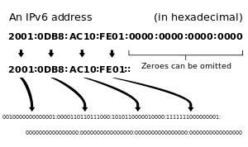
IPv6
IPv6 uses 128 bits rather than 32 bits to generate addresses which give 2¹²⁸ unique addresses.
They are arranged as groups of hexadecimal numbers.

Slide 6
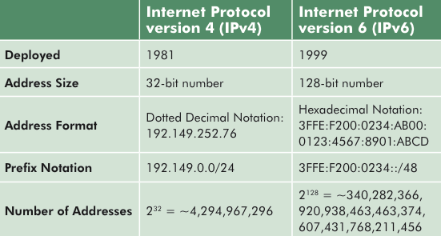
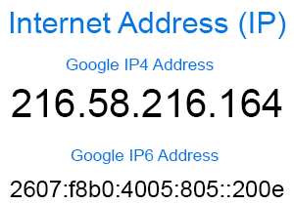
IPv4 versus IPv6

Slide 7
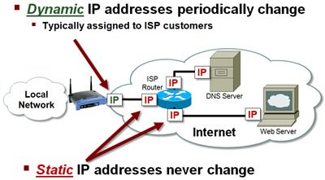
Static IP Addresses
If you own a public web site, the IP address of the server should never change.
If it changed, people would find it very difficult to reconnect to the website.
This is called a static IP address.

Slide 8
Dynamic IP Addresses
When a device is temporarily connected to the Internet a dynamic IP address is allocated to it.
When the device disconnects, the IP address becomes available for another device to use.
The dynamic address is generally allocated to a home router by the ISP when it connects.
Each time you connect a different address may be allocated.

Slide 9
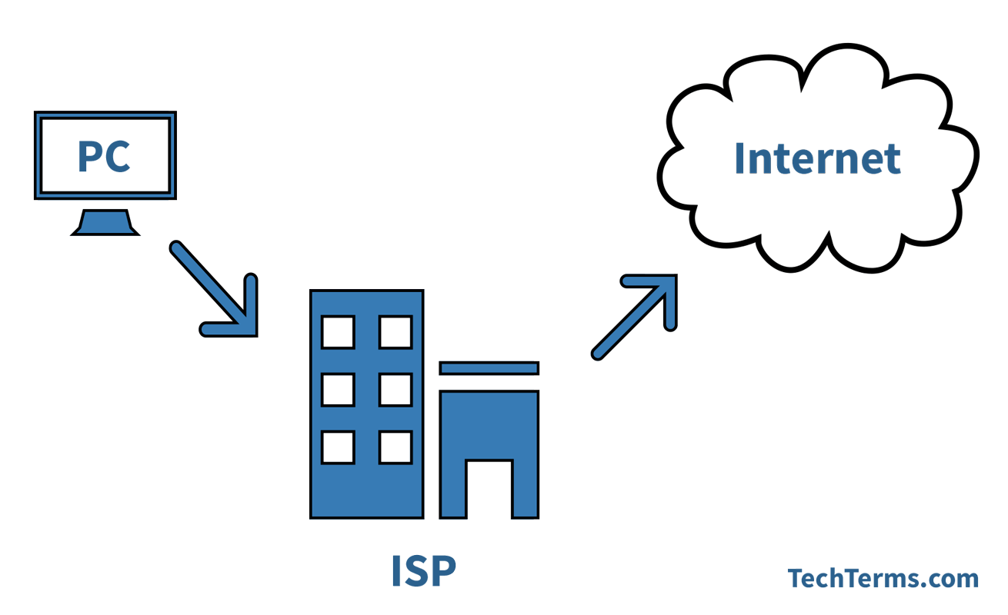
Internet Service Provider (ISP)
To connect to the internet you also need an ISP.
An ISP is a company that provides access to the Internet , usually for a monthly fee.
Your ISP will usually issue you with:
A router
A username and password
An email address
Many also offer extra services such as landlines and digital television services.

Slide 10
Uniform Resource Locator (URL)
When accessing a webpage we use a URL to access the page e.g. http://www.ocr.org.uk
http tells the computer to use the hypertext transfer protocol which puts the packets together to be used in a web browser
www tells us that this is a webpage and that it is located on the world wide web
ocr.org.uk is the domain name

Slide 11
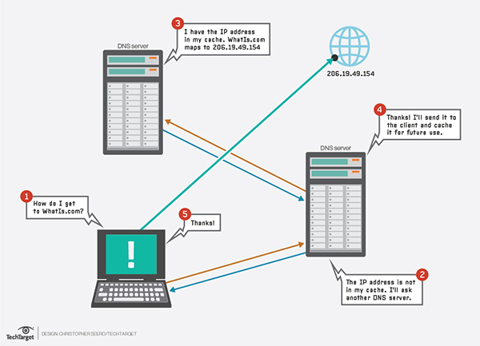
Domain Name Server (DNS)
When a URL is typed in, the web browser will query a DNS.
The DNS has a database of all domain names and their associated IP addresses which is constantly updated by other DNS servers

Slide 12
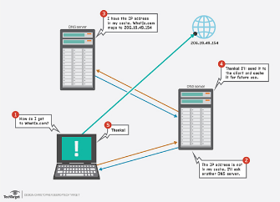
DNS Server
DNS Lookup Process:
User types in domain name and this is sent to DNS servers.
DNS servers map this domain to an IP address
If the DNS server can’t resolve, it passes the request (recursively) to another DNS server.
DNS Server sends the IP address to browser so it can retrieve the website from server on which it is hosted.
Without a DNS server the user would have to type in IP addresses to access a webpage.

Slide 13
DNS Server
Advantages
People do not need to remember IP addresses
As long as you are connected to a DNS server you can have access to all the addresses
Easily upgradable (eg IPv4 toIPv6) without all web addresses needing to be the same

Slide 14
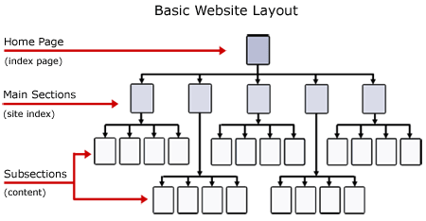
Web Sites
A website is a collection of web pages.
They are stored on a web server and arranged in a folder structure similar to My Documents.
The home page for a website is usually Index.html.
For a website to work and be available to the outside world it needs to be hosted on a web server.

Slide 15
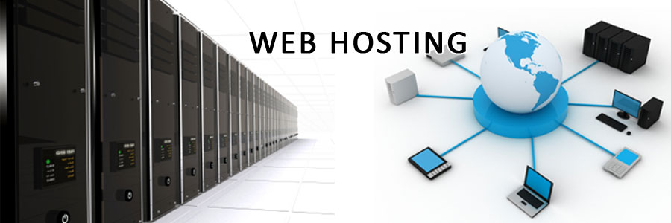
Hosting
When you want to publish a website, a suitable domain name names to be chosen e.g. myInterestingNetworkingSite.co.uk
The domain name needs to be registered with a domain registrar who would ensure that the domain name is unique and not already registered
Each registered domain name would have an associated IP address – this would then be registered on a DNS.

Slide 16
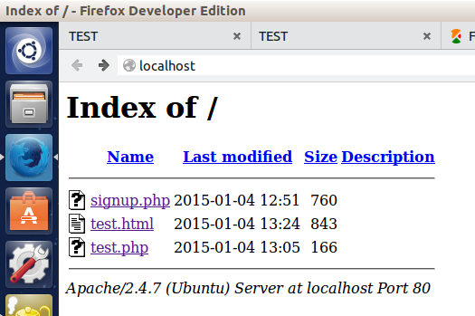
Local Hosting
Your own PC is set up as a web server which other devices can connect to.
The server is given a default address localhost.
Local hosting saves the costs of the monthly fees paid to external hosts.
However, you need a large bandwidth, your device would need to be continually on and connected and in this scenario it can be difficult to protect your device from malware etc.
Dynamic IP addresses can also cause problems.

Slide 17
External Hosting
An external company is paid to host the website on one of their web servers.
You can pay for a shared server where many other web sites will also be hosted on the same server. This could affect the performance, but the cost is usually lower.
A dedicated server is often used by companies who have a lot of website traffic as the server resources do not have to be shared.

Slide 18
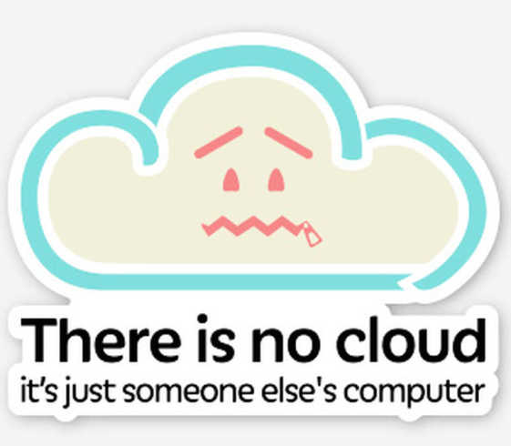
The Cloud
The cloud is a network of servers
Some servers will run applications
Some servers will store data
The benefits of the cloud are that you can
increase storage e.g. from mobile phones
Access files from anywhere in the world
Collaborate with others from around the world
Ensure that your data is backed up

Slide 19
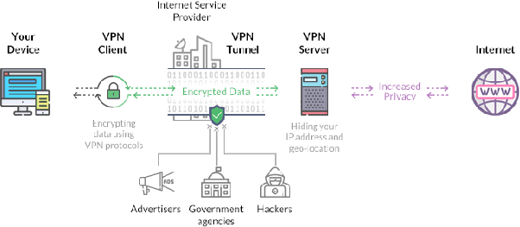
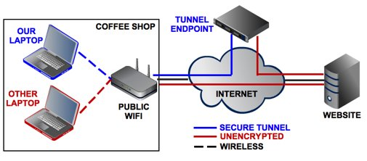
Virtual Private Network (VPN)
A VPN is a secure tunnel between two or more devices.
VPNs are used to protect private web traffic from snooping, interference, and censorship.
In the past, they were often used in business environments when an employer wanted to allow employees access to a secured internal network over the internet while working from home.

Slide 20
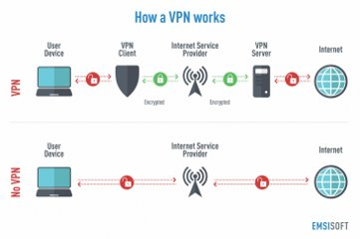
Virtual Private Network (VPN)
When your device connects to the internet, it connects to your ISP, which then connects your device to any website.
Your internet traffic crosses through your ISP’s servers and can be inspected by your ISP.
If your device uses a VPN, it connects to the VPN provider server via an encrypted connection (VPN tunnel). All internet traffic is encrypted and secured from eavesdropping.

Slide 21
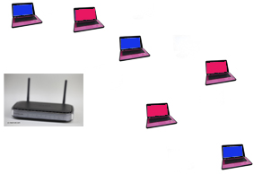
Virtual Networks
A virtual network is a smaller part of a LAN or WAN in which only specific machines can see each other.
In this example, the network administrator has set up the network so that the red machines can only see each other and share data.
They are invisible to the blue computers.

Slide 22
Virtual Networks
The red computers may be the school administration computers used to handle school matters whilst the blue ones are the normal student computers.
They share the same network hardware and cabling but the student machines cannot access anything on the red computers or vice versa.

